Slide 1
^{The} Smarter Balanced Assessment
Introductory Information for Parents, Educators and Community Members
Alisha DiCorpo
Director of Curriculum, Instruction and Assessment
Thomaston Public Schools

Slide 2
What will be different about the new tests?
Align to Career and College Readiness Standards in mathematics and English language arts/literacy
Rigorously assess progress toward “college and career readiness”
Provide achievement and growth information
Use assessments that are valid, reliable, and fair for all students (Note: Alternate assessments still needed for small percentage of student)
Use multiple measures of student performance
Use online technologies

Slide 3
How will SBAC be different from CMT?
Smarter Balanced
CMT
Content Standards
Common Core State Standards | Grade-Level Expectations
On Track to be Career and College Ready | Prepared for Next Grade Level Learning
Web-Based | Pencil and Paper
Computer Adaptive | Fixed Form/Common Item Set
Summative, Interim and Formative | Summative
Multiple Choice, Short Answer, Tech Enhanced, Performance Task | Multiple Choice, Short Answer, Constructed response
12 Weeks/Spring | 3 Weeks/ Fall
Some Scores Available Immediately; Remainder in About 1 Month | About 3 Months
Achievement Descriptors
Test Format
Item Delivery
Assessment Types
Item Types
Testing Window
Results Turnaround

Slide 4
What’s so “balanced” about Smarter Balanced?
Summative assessments
Benchmarked to CCSS; Combine Computer Adaptive and Performance Tasks
Teachers and schools have information and tools they need to improve teaching and learning
Common Core State Standards specify
K-12 expectations for college and career readiness
All students leave high school college and career ready
Teacher resources for
formative assessment practices
to improve instruction
Interim assessments Flexible, open, used for actionable feedback

Slide 5
What's so special about Computer Adaptive Testing (aka CAT)?
Increased precision
Provides accurate measurements of student growth over time
Tailored for Each Student
Item difficulty based on student responses
Increased Security
Larger item banks mean that not all students receive the same questions
Shorter Test Length
Fewer questions compared to fixed form tests
Faster Results
Turnaround time is significantly reduced
Mature Technology
GMAT, GRE, SAT,(ACT), Measures of Academic Progress (MAP)

Slide 6
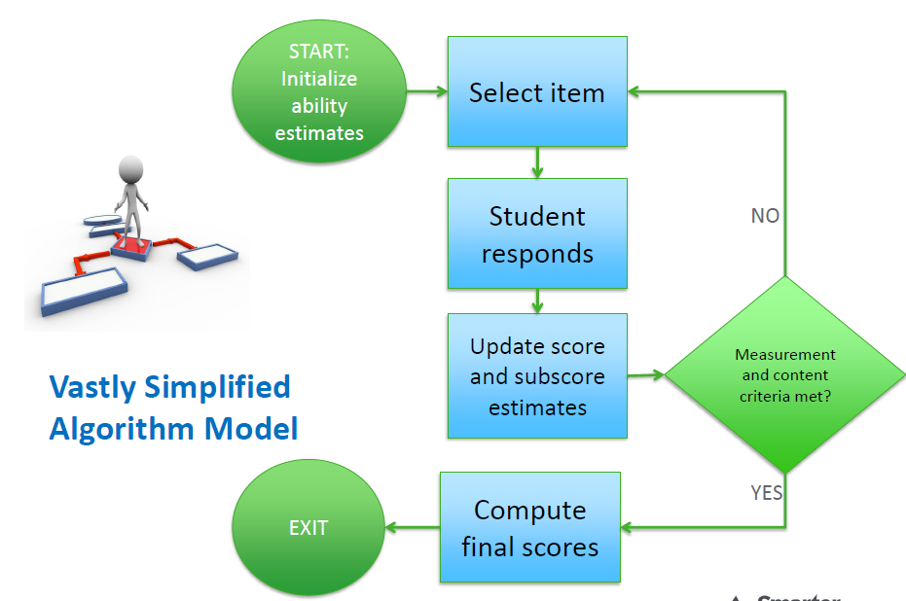
How does a CAT work?
Is the estimate as accurate as we can make it?

Slide 7
What is a summative assessment?
Summative Assessment (Computer Adaptive)
Assesses the full range of Common Core in English language arts and mathematics for students in grades 3–8
Measures current student achievement and growth across time, showing progress toward college and career readiness
Can be given once a year (mandatory testing window within the last 12 weeks of the instructional year)
Includes a variety of question types: selected response, short constructed response, extended constructed response, technology enhanced, and performance tasks

Slide 8
What role will performance tasks play?
Performance Tasks
“
Extended projects demonstrate real-world writing and analytical skills
May include online research, group projects, presentations
Require 1-2 class periods to complete
Included in summative assessments
Applicable in all grades being assessed
The use of performance measures has been found
to increase the intellectual challenge in classrooms
and to support higher-quality teaching.
- Linda Darling-Hammond and Frank Adamson, Stanford University
”

Slide 9
How long are the summative tests?
Grade | ELA (CAT Only) | Mathematics (CAT and PT) | Total
3 | 1:33 | 1:49 | 3:22
4 | 1:35 | 1:45 | 3:20
5 | 1:30 | 2:07 | 3:37
6 | 1:33 | 1:55 | 3:28
7 | 1:21 | 1:37 | 2:58
8 | 1:19 | 1:43 | 3:02

Slide 10
BRS Testing Schedule (Grade 3 Only)
Date | Day | Test | Length of Test | Testing Time
May 3, 2016 | Tuesday | Computer Adaptive ELA | 80 Minutes | 8:45-10:05am
MAY 4, 2016 | Wednesday | Computer Adaptive ELA Makeup | 80 Minutes | 8:45-10:05am
May 5, 2016 | Thursday | Computer Adaptive Math | 80 Minutes | 8:45-10:05am
May 6, 2016 | Friday | Computer Adaptive Math Makeup | 80 Minutes | 8:45-10:05am
May 9, 2016 | Monday | Math Performance Task | 60 Minutes | 9:00-10:00am
May 10, 2016 | Tuesday | Math Performance Task Makeup | 60 Minutes | 9:00-10:00am

Slide 11
TCS Testing Schedule
Date | Day | Test | Length of Test | Testing Time
May 9, 2016 | Monday | Computer Adaptive Test ELA | 120 minutes | 8:45-10:45 am (4) 9:15-11:15 am (5) 9:45-11:45 am (6)
May 10, 2016 | Tuesday | CAT ELA Makeup | 120 minutes | 8:45-10:45 am (4,5,6)
May 11, 2016 | Wednesday | Computer Adaptive Test Math | 120 minutes | 8:45-10:45 am (4) 9:15-11:15 am (5) 9:45-11:45 am (6)
May 12, 2016 | Thursday | Math CAT Makeup | 120 minutes | 8:45-10:45 am (4, 5,6)
May 17, 2016 | Tuesday | Performance Task Math | 120 minutes | 8:45-10:45 am (4) 9:15-11:15 am (5) 9:45-11:45 am (6)
May 18, 2016 | Wednesday | Performance Task Math Make up | 120 minutes | 8:45-11:45 am (4,5,6)

Slide 12
THS Testing Schedule (Grades 7+8 Only)
Date of Test | Day of Week | Name of Test | Duration | Time of Assessment | Proctors
April 28, 2016 Day 5 | Thursday | CAT Summative ELA | 1 hour 40 minutes | 8:18am-10:02am | Grade 8 Grade 7 Long Guerrera Laus Fuller Jaskelewicz Ellis Mazzini Malo Pope Smith
April 29, 2016 Day 6 | Friday | CAT Summative ELA Make up Room 102 | 1 hour 40 minutes | 8:18am-10:02am | Henderson-Grades 7 and 8
May 2, 2016 Day 7 | Monday | CAT Summative Math | 1 hour 40 minutes | 8:18am-10:02am | Grade 8 Grade 7 Long Guerrera Fuller Jaskelewicz Ellis Mazzini Malo Pope Smith
May 3, 2016 Day 1 | Tuesday | CAT Math Makeup Room 102 | 1 hour 40 minutes | 8:18am-10:02am | Henderson-Grades 7 and 8
May 4, 2016 Day 2 | Wednesday | Math Performance Task | 1 hour 15 minutes | 8:18am-10:02am | Grade 8 Grade 7 Long Guerrera Jaskelewicz Ellis Fuller Mazzini Malo Pope Smith
May 5, 2016 Day 3 | Thursday | Math Performance Task Make-up | 1 hour 15 minutes | 8:18am-10:02am | Henderson-Grades 7 and 8

Slide 13
What are the English Language Arts reporting areas (aka “claims”)?
Overall Claim for Grades 3-8
“Students can demonstrate progress toward college and career readiness in English Language arts and literacy.”
Claim #1 - Reading
“Students can read closely and analytically to comprehend a range of increasingly complex literary and informational texts.”
Claim #2 - Writing
“Students can produce effective and well-grounded writing for a range of purposes and audiences.”
Claim #3 - Speaking and Listening
“Students can employ effective speaking and listening skills for a range of purposes and audiences.”
Claim #4 - Research/Inquiry
“Students can engage in research and inquiry to investigate topics, and to analyze, integrate, and present information.”

Slide 14
What are the mathematics reporting areas (aka “claims”)?
Overall Claim for Grades 3-8
“Students can demonstrate progress toward college and career readiness in mathematics.”
Claim #1 - Concepts & Procedures
“Students can explain and apply mathematical concepts and interpret and carry out mathematical procedures with precision and fluency.”
Claim #2 - Problem Solving
“Students can solve a range of complex well-posed problems in pure and applied mathematics, making productive use of knowledge and problem solving strategies.”
Claim #3 - Communicating Reasoning
“Students can clearly and precisely construct viable arguments to support their own reasoning and to critique the reasoning of others.”
Claim #4 - Modeling and Data Analysis
“Students can analyze complex, real-world scenarios and can construct and use mathematical models to interpret and solve problems.”

Slide 15
Does CAT have any special advantages for special students?
PRECISE – Unlike fixed form tests, CAT is precise at all ability levels, not just at the proficient cut score
EFFICIENT – Takes less items than fixed form tests to reach a valid and reliable estimate of ability, reducing testing time by as much as 50%; results are available almost immediately.
RESPONSIVE & HUMANE – CAT algorithm produces an individual item set for each student, adapting after each student response; item set comprised of items the student CAN and CAN’T answer in equal proportion
Secure and Adaptable – CAT eliminates most test security concerns of fixed form tests allowing for longer test windows and small group or individualized administrations

Slide 16
But what about students who don’t have much experience with computer testing?
Students will have several opportunities to practice prior to the “official” testing:
Sample items (currently available on Smarter website)
Practice tests Interim assessment

Slide 17
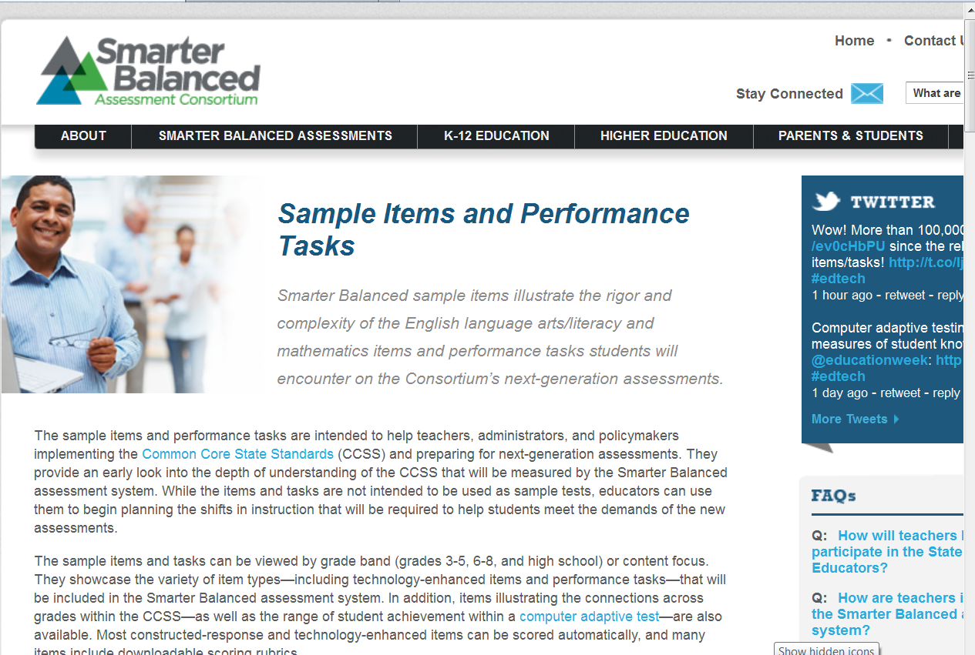
Sample Items? Can we see some of those?
Showcases the variety of item types:
Selected response
Constructed response
Technology enhanced
Performance tasks
http://sampleitems.smarterbalanced.org/itempreview/sbac/ELA.htm

Slide 18
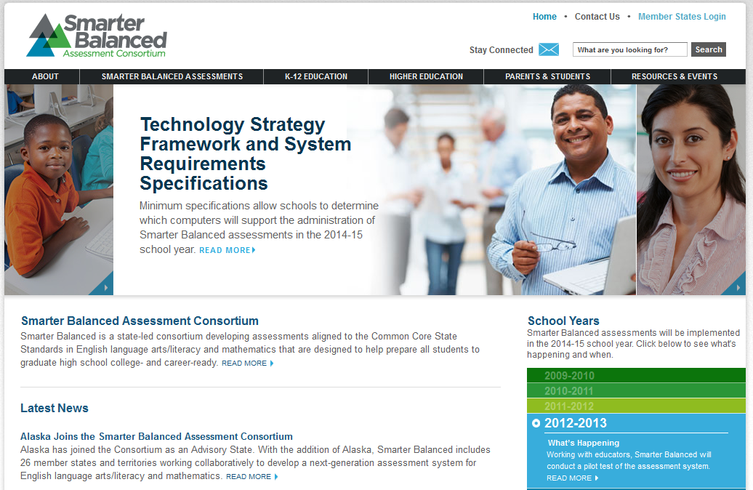
Where can I learn more about Smarter Balanced?
On the web @ www.SmarterBalanced.org
Sign up for the Smarter Balanced e-newsletter
Follow the consortium on Twitter @SmarterBalanced

Slide 19
Questions
What else would you like to know?

